Slide 1
COSP230 Ch. 1
Getting started with Android Studio

Slide 2
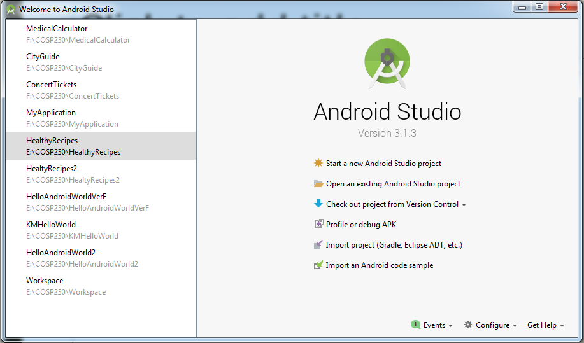
Here is the initial screen…

Slide 3
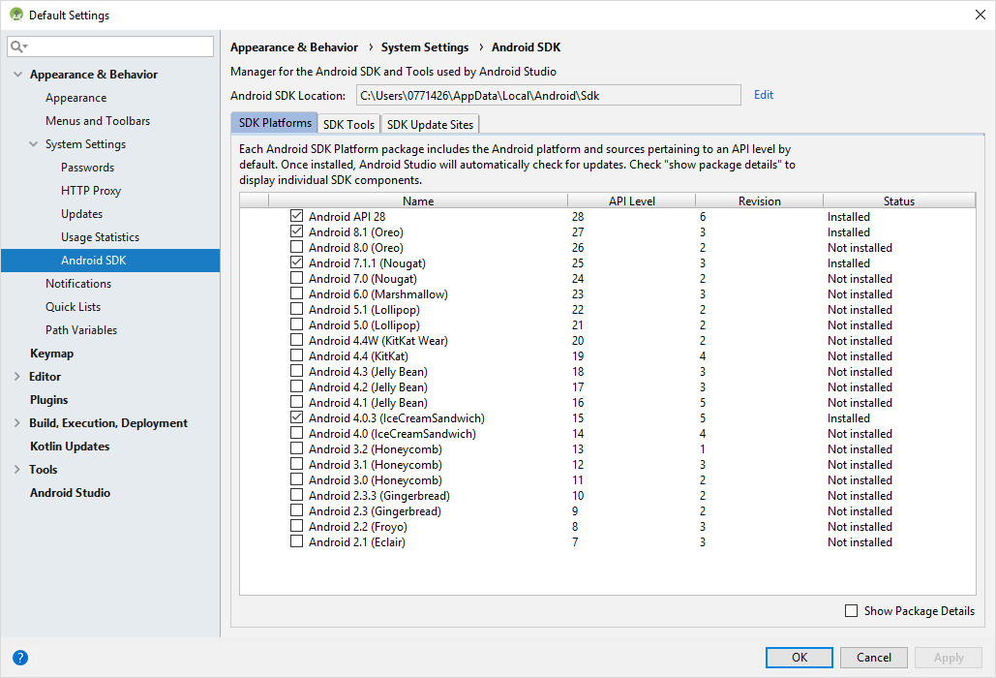
If SDK not installed, click Configure…, go to SDK Manager, select Android 4.0.3 (IceCreamSandwich), and click Apply.

Slide 4
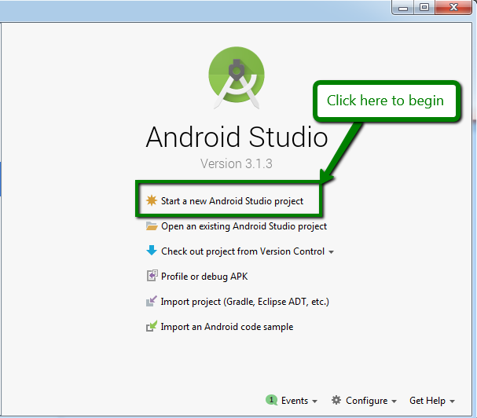
Open a new Android Studio project

Slide 5
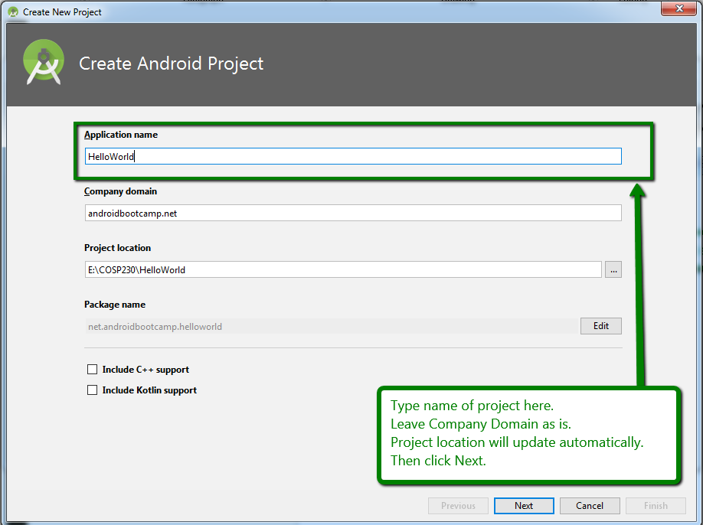
Give the project a name

Slide 6
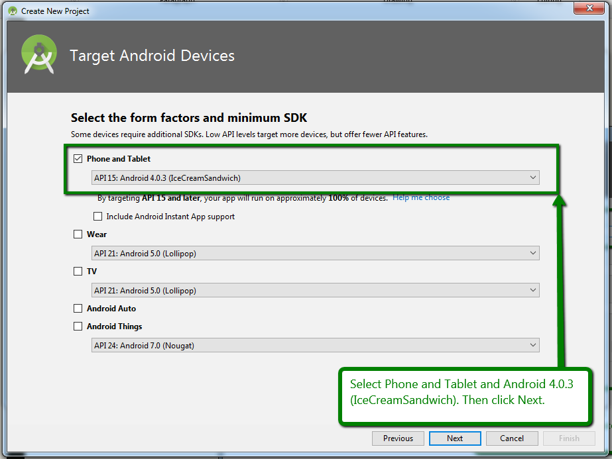
Select Form Factors and Minimum SDK

Slide 7
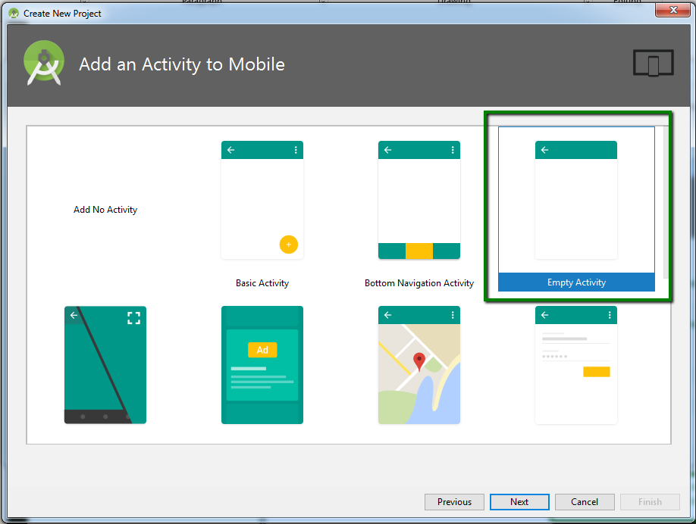
Select Empty Activity

Slide 8
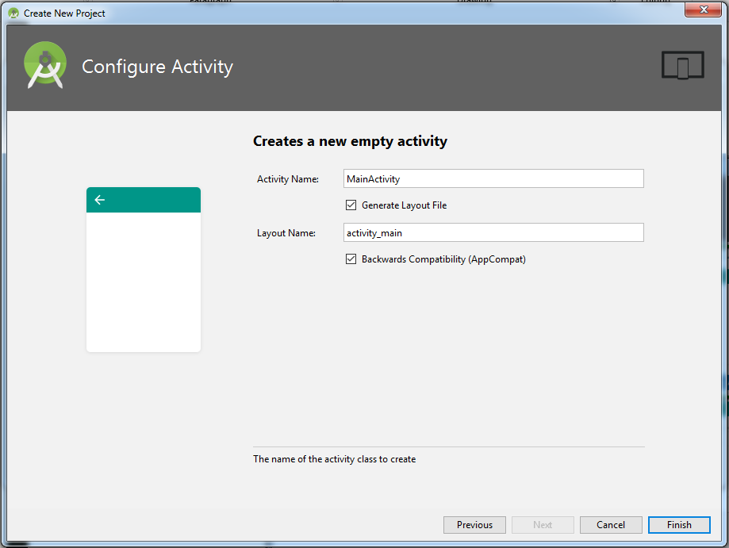
Configure Activity – No changes, click Finish… and wait…

Slide 9
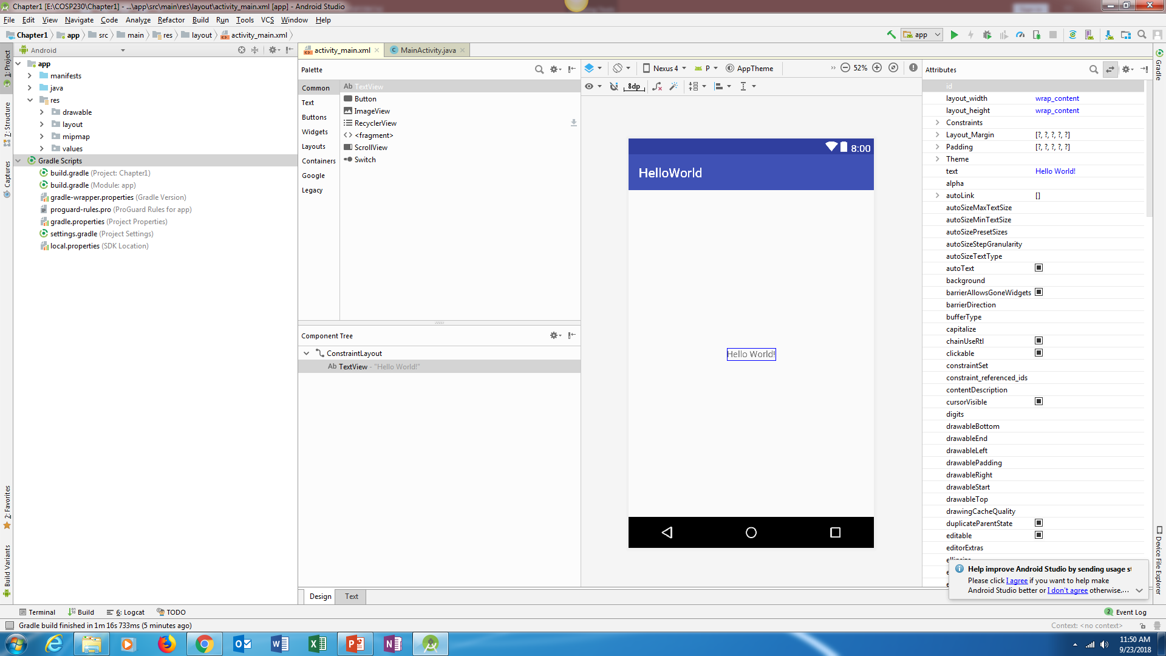
Eventually, you get something like this:

Slide 10
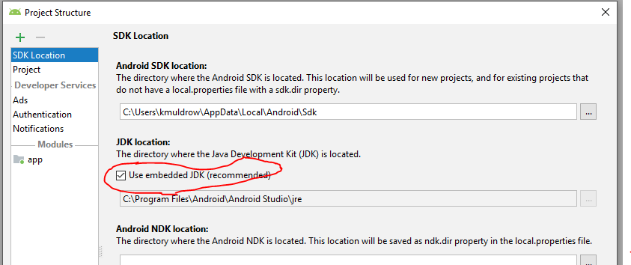
If there are errors, go to File…, select Project Structure…, and make sure the box shown below is checked:

Slide 11
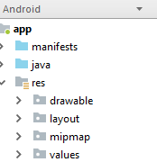
Android Project View
Appears on left side of program window
Contains key source application folders for the project, including…
manifests – Contains all info about application that Android need to run (in AndroidManifest.xml file)
java – includes Java source codes for the project
res – contains all resources, like images, music, and video files, that the app might need

Slide 12
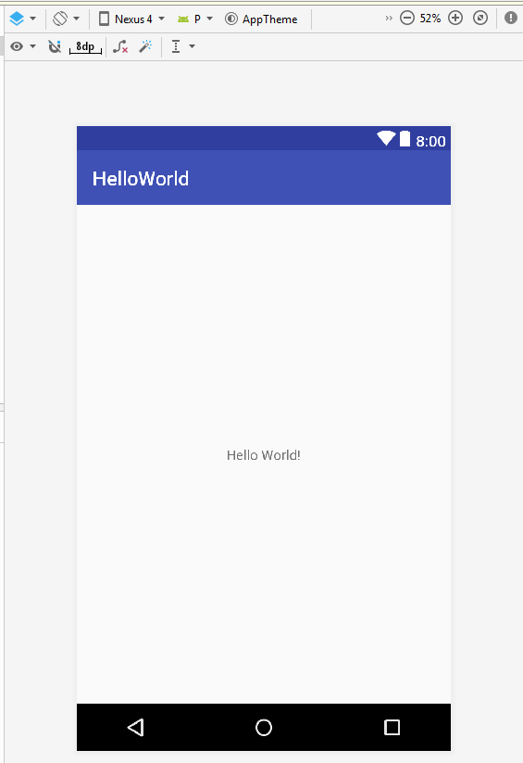
Android Virtual Device (AVD)
Displays an emulator configuration for design and layout purposes.
This will appear as its own window every time you run your program.
But…
It’s quite slow, so be patient when running
When it first appears, it will display the previous version of your program before updating to the new version

Slide 13
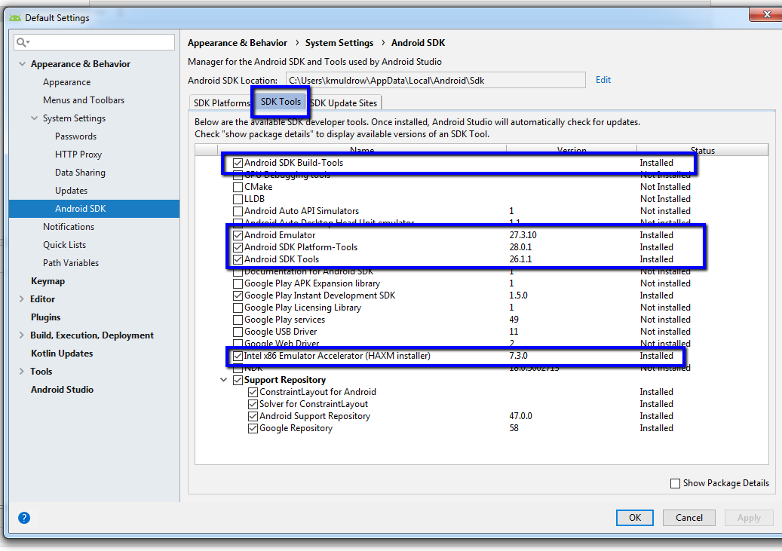
Make sure AVD (emulator) will work, Part 1
Part 1:
Click on Tools in menu bar
Select SDK Manager from the menu
In the window that appears, click the SDK Tools tab.
Make sure everything in a blue box in the picture on the right is “Installed”.
If any of them are not installed, click the check box next to the ones that are not installed and click Apply in the bottom right.
Once these are installed, click OK.

Slide 14
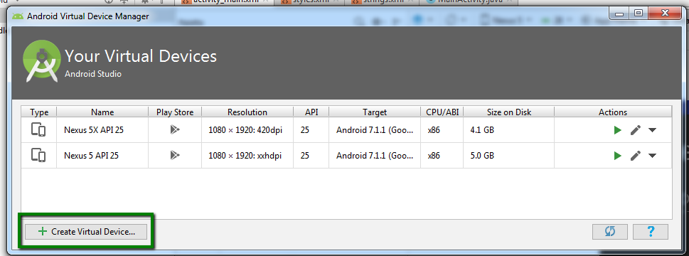
Make sure AVD (emulator) will work, Part 2
Part 2:
Click on Tools in menu bar
Select AVD Manager from the menu In the Select Hardware window:
Click the Create Virtual Device button in the bottom left.

Slide 15
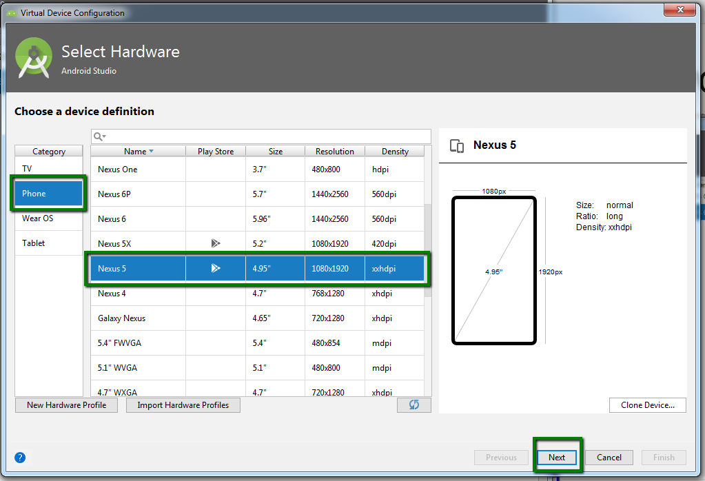
Make sure AVD (emulator) will work, Part 3
Part 3
In the Select Hardware window:
Select Phone in the Category area
Select Nexus 5 from the list of devices.
Click Next.

Slide 16
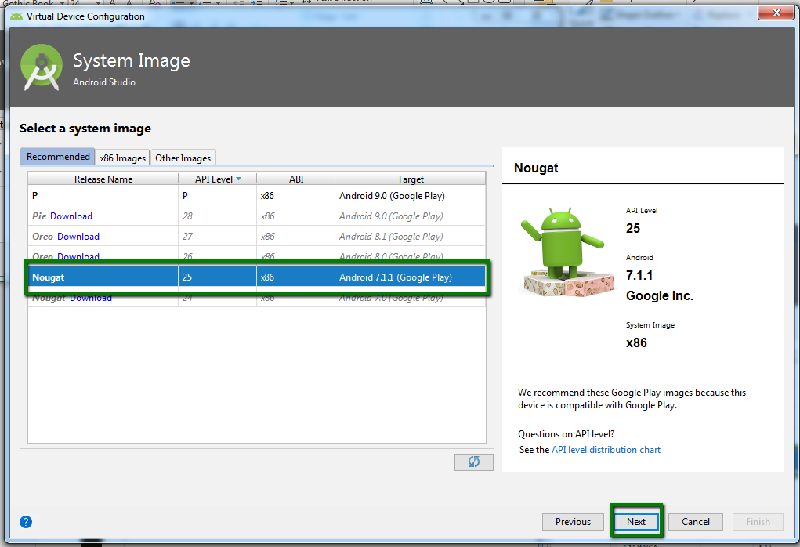
Make sure AVD (emulator) will work, Part 4
Part 4
In the System Image window:
Click the Recommended tab
Select Nougat with an API Level of 25
Can select others, but this one does not require a download
Click Next.

Slide 17
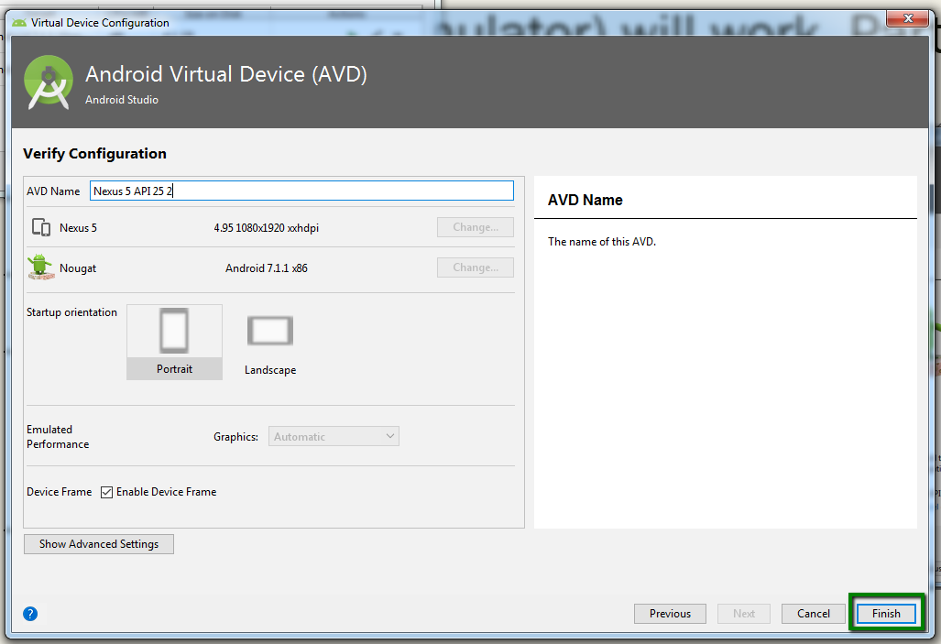
Make sure AVD (emulator) will work, Part 5
Part 5
In the Verify Configuration window:
Make sure everything is how you want it.
Click Finish.

Slide 18
Type of AVD
Click to display drop-down menu
Select this: Nexus 5 (5.0”, 1080x1920 dpi)

Slide 19
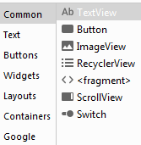
Palette
Contains all the different widgets for the AVD
Widget – any single element, such as a TextView, Button, ImageView, etc.

Slide 20

Component Tree
Defines how widgets are positioned within the AVD
We will mostly use the ConstraintLayout

Slide 21
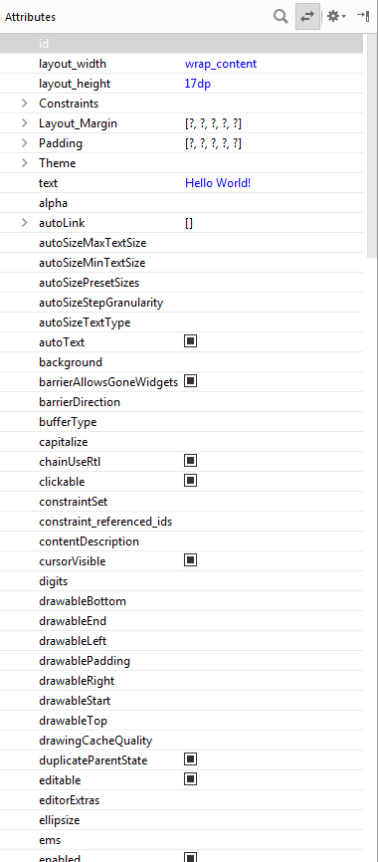
Attributes Window
Also known as the Properties Window
Can be used to view and change properties of a selected widget on the ADV.
You can change the Text property of a TextView widget to display different text.
However, Android recommends adding resources within the res folder. This is done by adding XML tags.

Slide 22
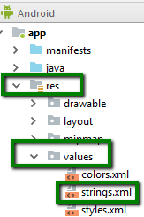
How to get to the Strings.xml file
In the Android project view…
Click arrow next to res folder
Click arrow next to values folder
Double-click strings.xml

Slide 23

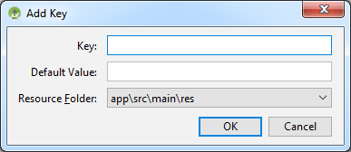
Translations Editor
Click Open Editor link on right side.
You will see the top picture on the right.
Click the green plus box at the top left
In the Add Key window, do the following:
Type text in the Key: field
Type Hello World! It’s Kyle Muldrow! (use your first and last name) in the Default value: field
Click OK

Slide 24
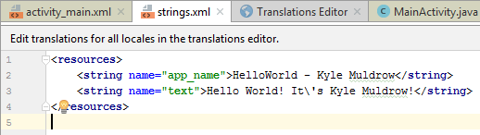
Verify Change
Click the “x” on the right of the Translation Editor Tab.
If needed, click the strings.xml tab at the top.
The strings.xml file should look like the picture on the right.

Slide 25
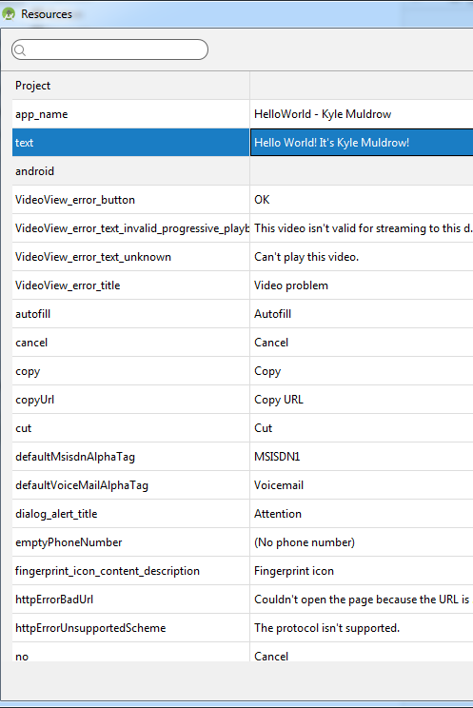
Update TextView widget
Click activity_main.xml tab at the top.
Click the TextView widget in the AVD.
In the Attributes window on the right, find the text property.
Click the three dots (…) to display the Resources window.
Select the text property you created.
Click OK.
The TextView widget should have the new text displayed.
The text property in the Attributes window should say this:
@string/text

Slide 26
Compile and run the app
Type Ctrl+S to save everything in your project.
Click the green “play” button in the picture on the right.
Please be aware it could take several minutes to finish compiling and then run the project.

Slide 27
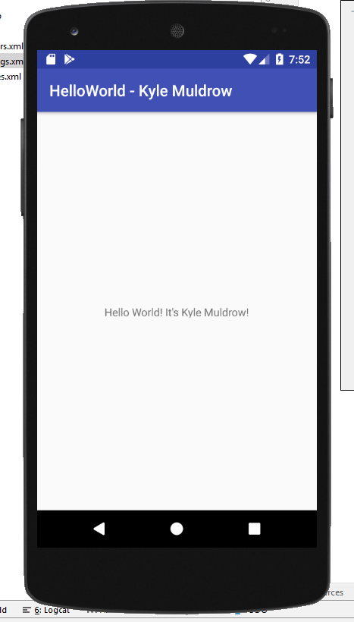
Eventually, you get this…

